Slide 1


Development Progress Status Report
CANADIAN HATE CRIME ANALYSIS
Prepared by:
Aravind Pradeep Kunnel
Namood-E-Sehar
Omar Mukhtar
Annee Amitkumar Mahida

Slide 2
About Project
Meet Our Team
Project Status
Timeline
Activities completed
Issues and Challenges
Communication and team meetings
Activities to be completed this week
CONTENTS

Slide 3

About Project
Addressing rising hate crimes, our project aims to analyze, predict, and mitigate future occurrences in Canada. Leveraging data-driven insights, our interdisciplinary team at HateWatch Intelligence, supported by Palantir Technologies Inc, conducts comprehensive predictive analysis. Through meticulous data cleaning, visualization, and predictive modeling, we aim to forecast hate crime trends over the next decade. Our goal is to empower stakeholders with actionable insights, enabling proactive interventions, policy recommendations, and community-driven initiatives to combat hate crimes and foster a more inclusive and equitable society

Slide 4
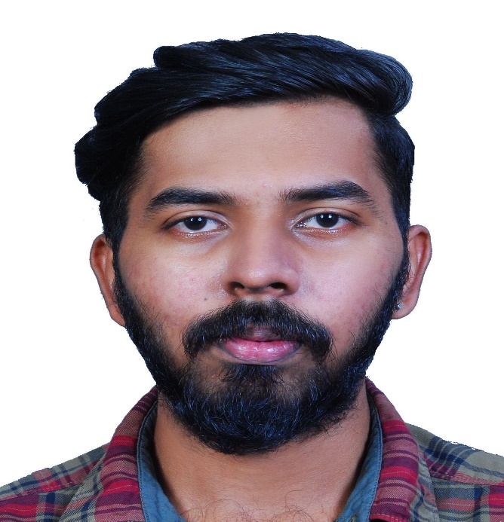
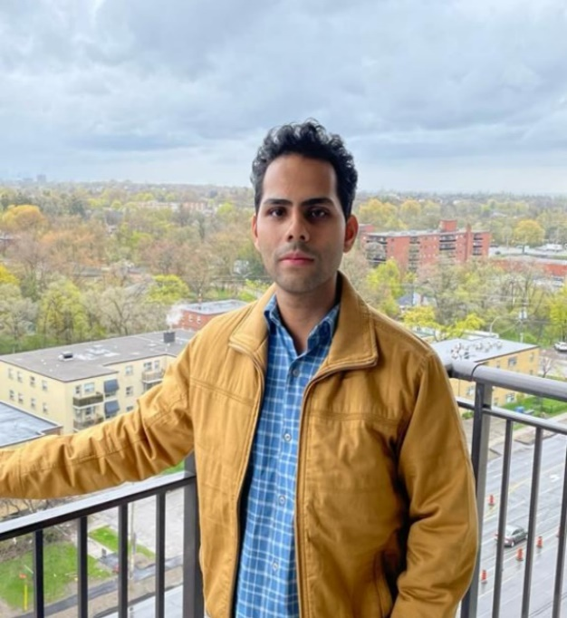

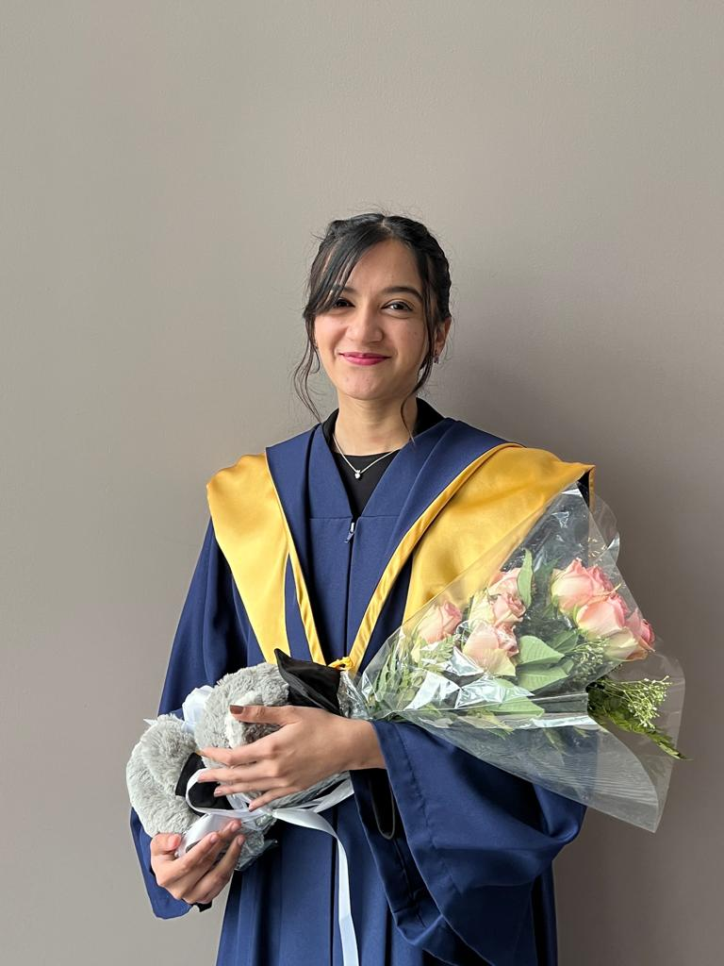
MEET OUR TEAM
Aravind Pradeep Kunnel
Omar Mukhtar
Namood-e-Sehar
Annee Mahida
Programmer
Data Analyst
Business Analyst
Manager

Slide 5

PROJECT STATUS
On Track
The project is progressing smoothly. The team has made significant advancements in doing Predictive Analysis on the Hate Crimes by type of motivation (2014-2022).

Slide 6
TIMELINE
Requirement Phase Data Phase Development and Release Phase
Testing Phase
August 11, 2023, September 14, 2023, September 23, 2023, September 25, 2023, October 17, 2023, November 2, 2023
Of charter and proposal Datasets Create visualizations Model Development Model Validation Final Documentation
July 21, 2023, September 11, 2023, September 18, 2023 October 2, 2023 December 8, 2023
Start working Retrieve Datase Clean the Datasets Model Testing Hand Over
on Charter of Deliverables
Completed Current phase

Slide 7


01
Requirements

Slide 8
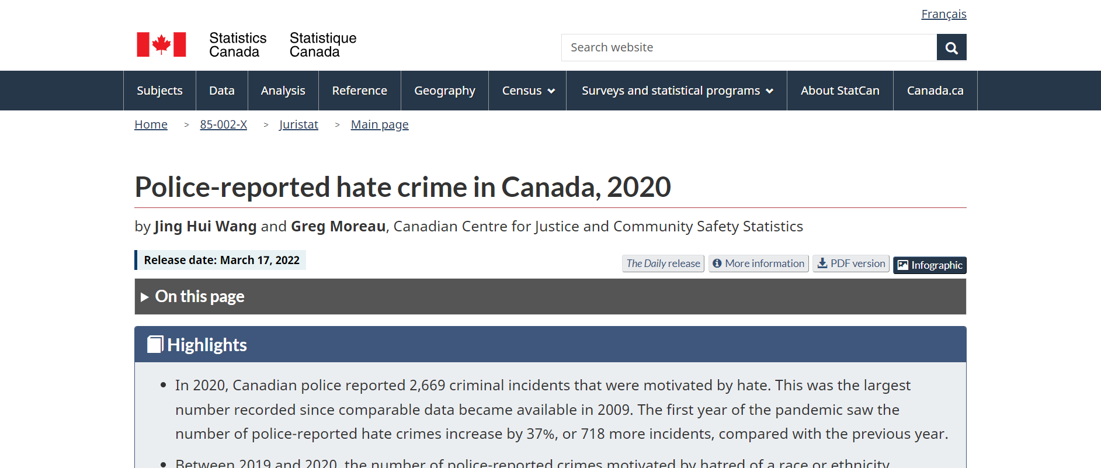
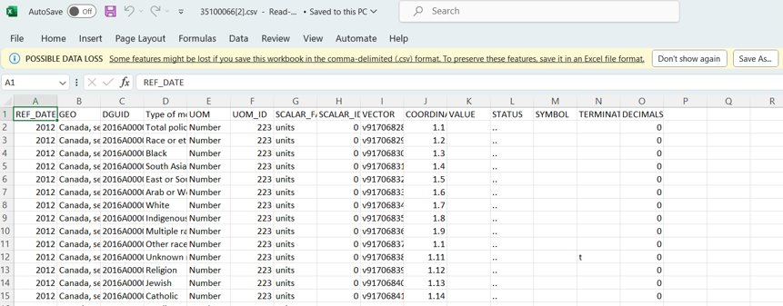
The Dataset
Website reference : https://www150.statcan.gc.ca/n1/pub/85-002-x/2022001/article/00005-eng.htm

Slide 9
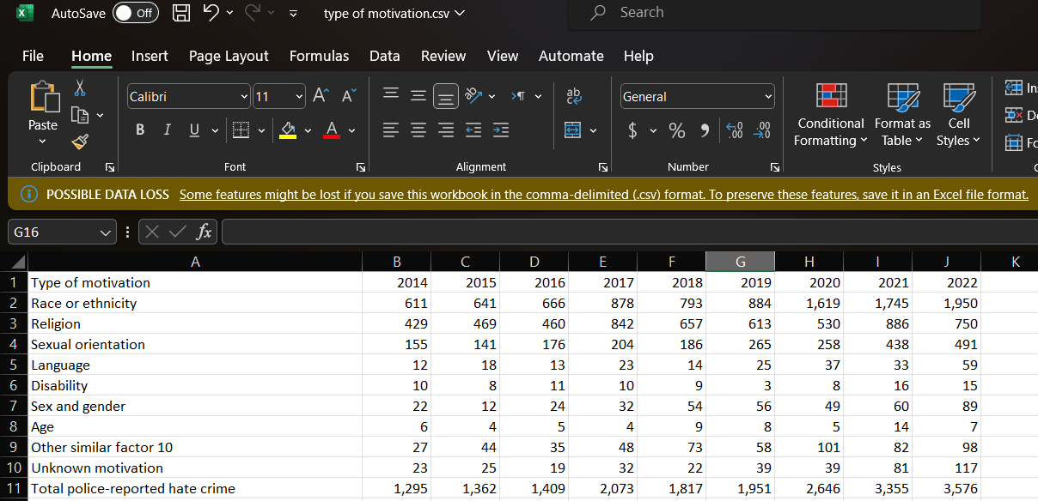
Police Reported Hate Crimes By Type of Motivation
Website reference : Police-reported hate crime, by type of motivation, Canada (selected police services) (statcan.gc.ca)

Slide 10
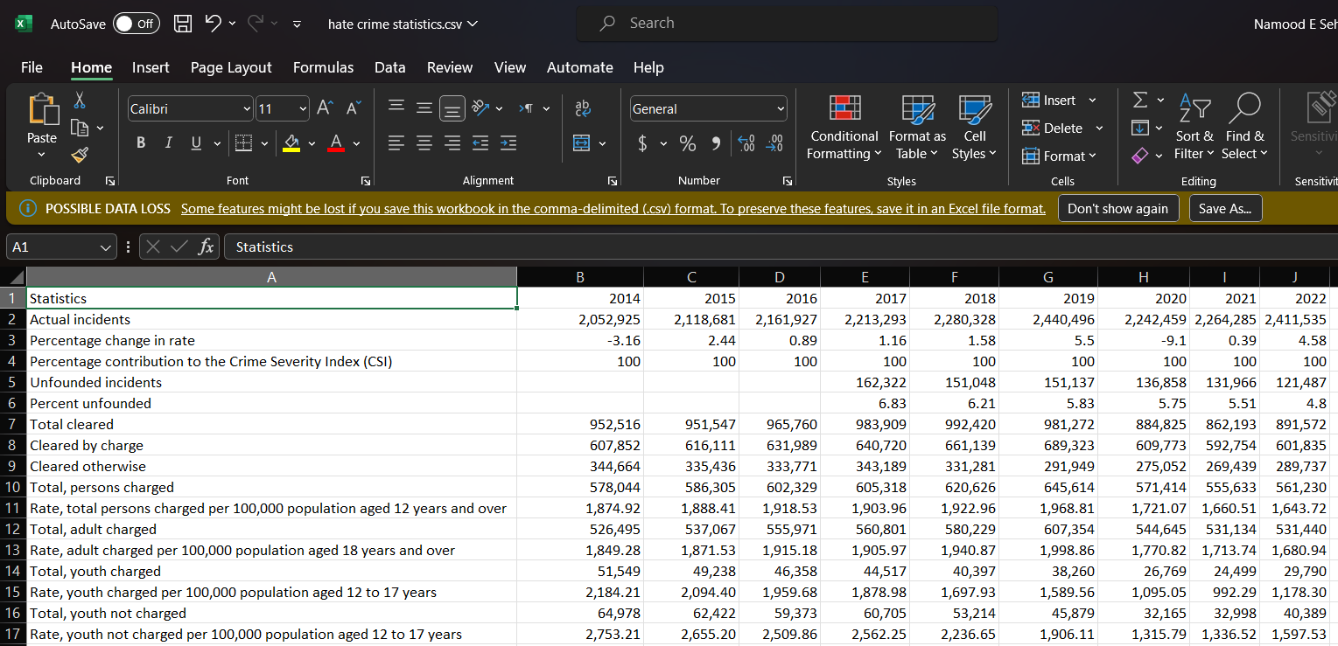
Police Reported Hate Crimes Statistics
Website reference : https://www150.statcan.gc.ca/t1/tbl1/en/tv.action?pid=3510017701

Slide 11
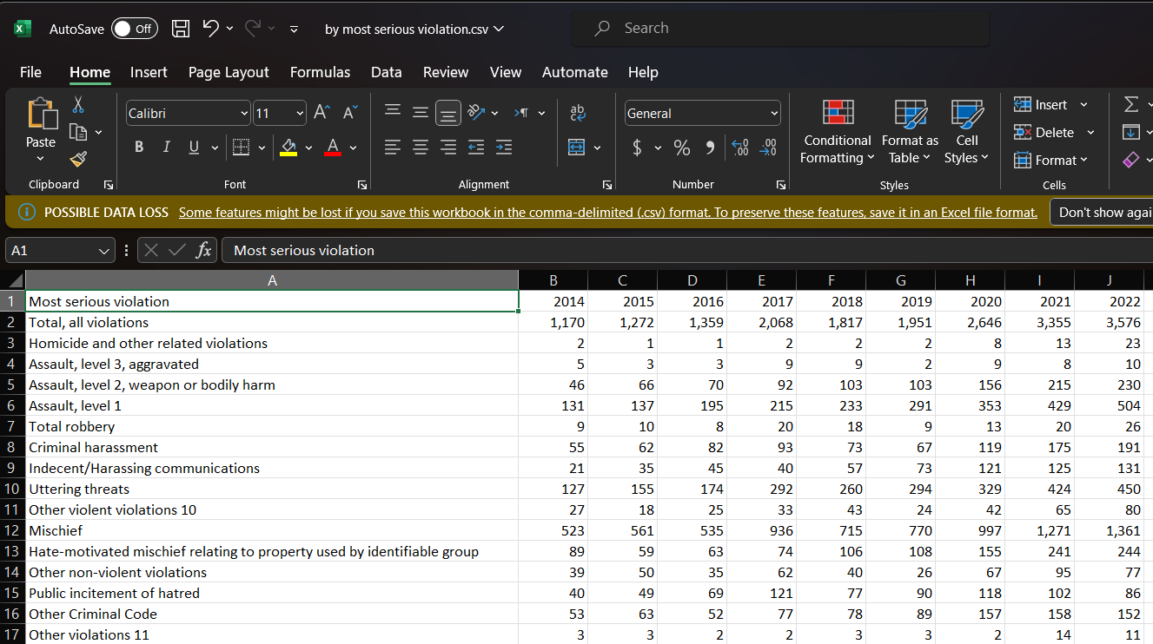
Police Reported Hate By Most Serious Violation
Police-reported hate crime, by most serious violation, Canada (selected police services) (statcan.gc.ca)

Slide 12
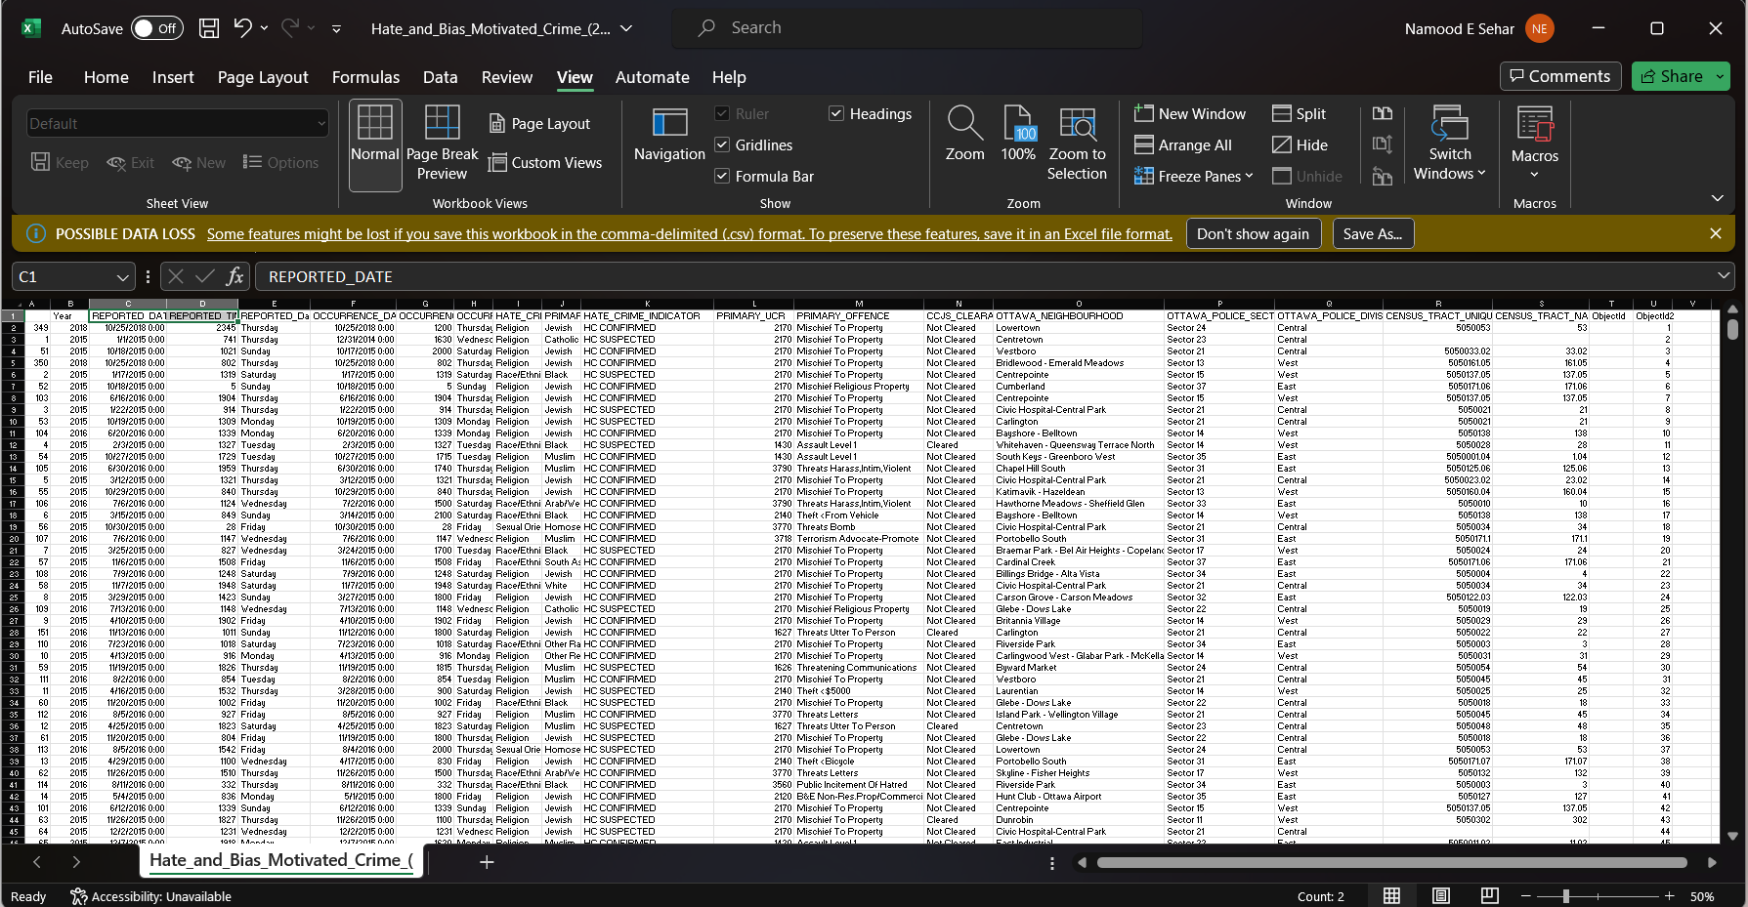
Hate and Bias Motivated Crimes Ottawa
Website reference : https://georgiancollege.maps.arcgis.com/home/item.html?id=a8b6defa93cc43cea925876ba8ea7cda#data

Slide 13

02
Design

Slide 14
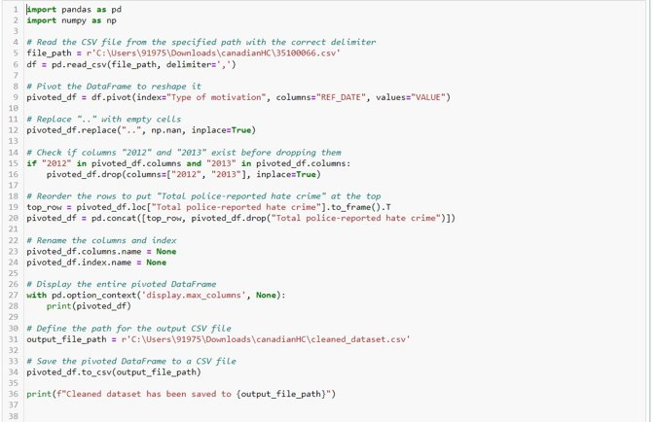
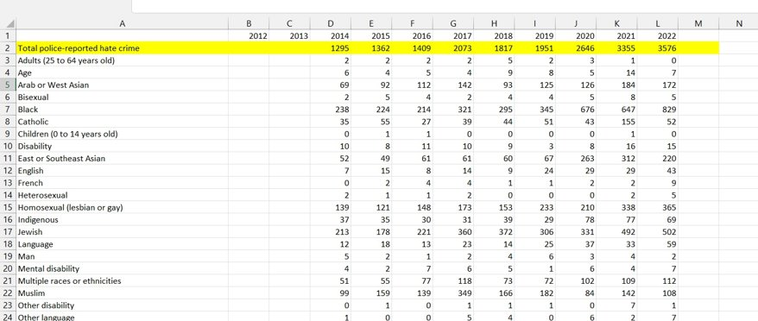
Python Code has been used to Clean the Raw Datasets
Python Code
Row Data
Cleaned Data
Raw Data
Cleaned Data

Slide 15
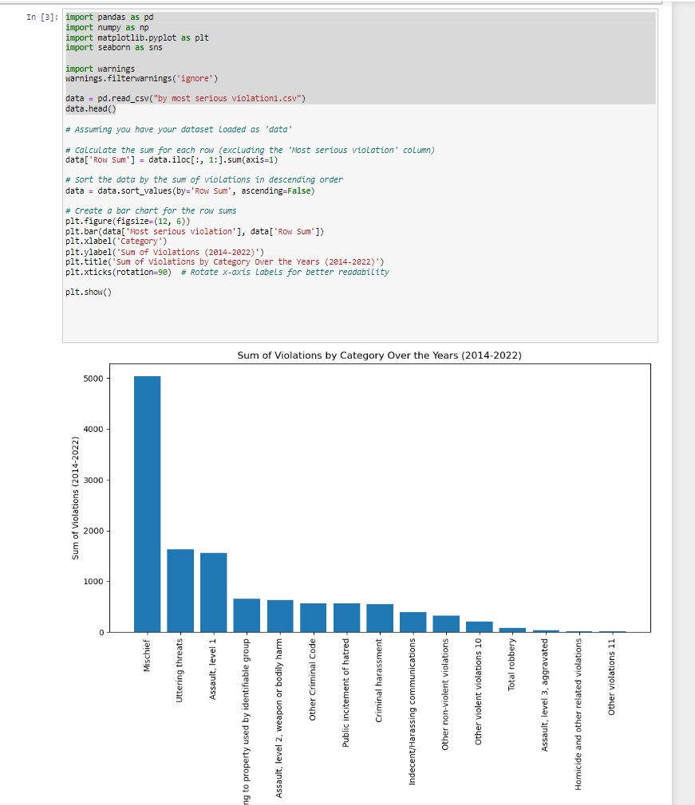
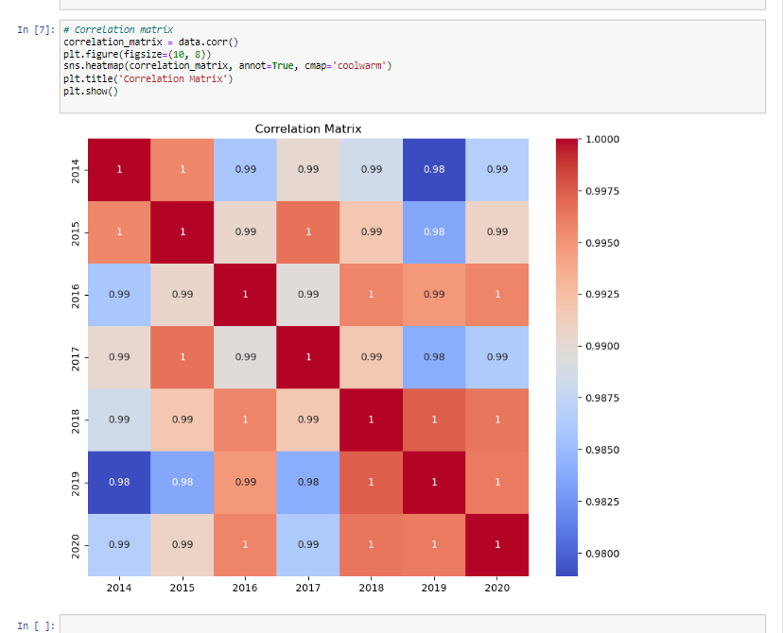
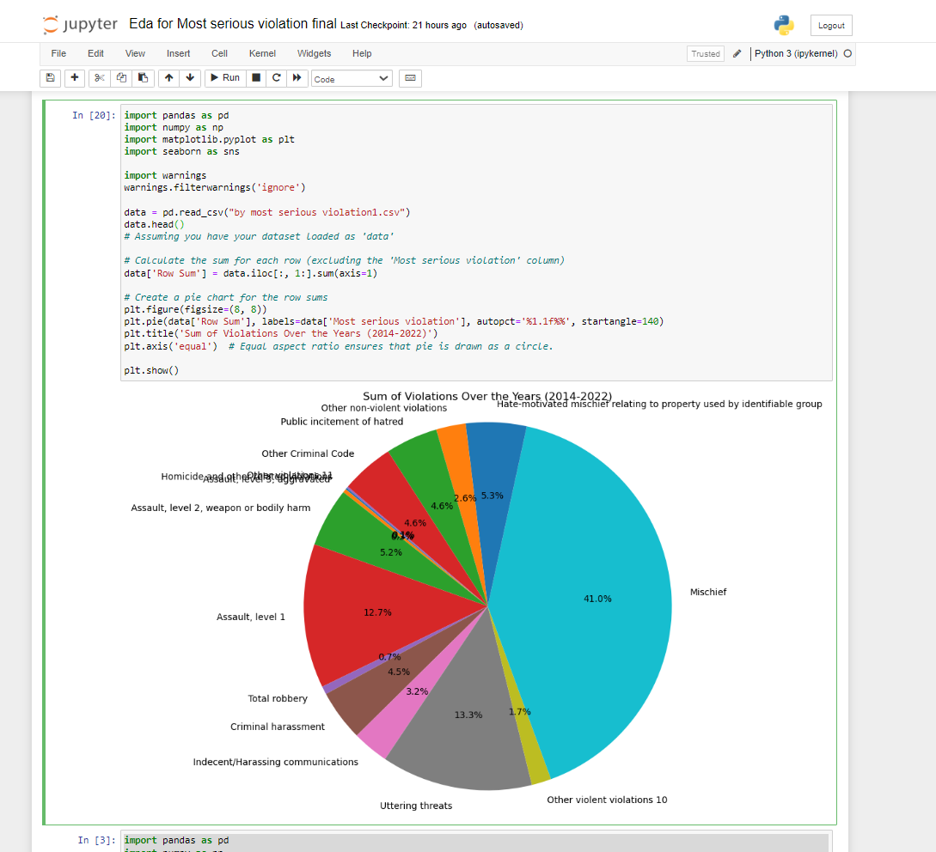
EDA Process
Python Code
Row Data
Cleaned Data

Slide 16
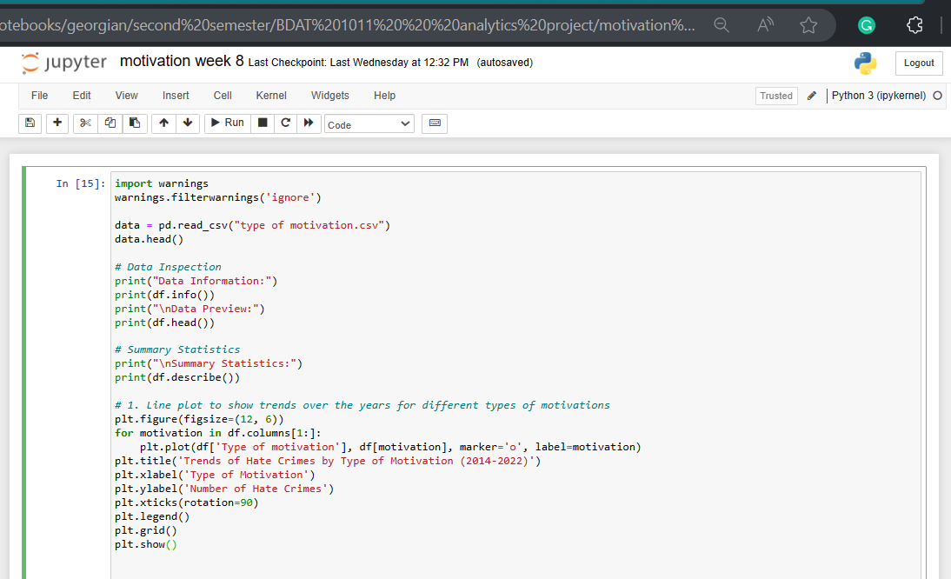
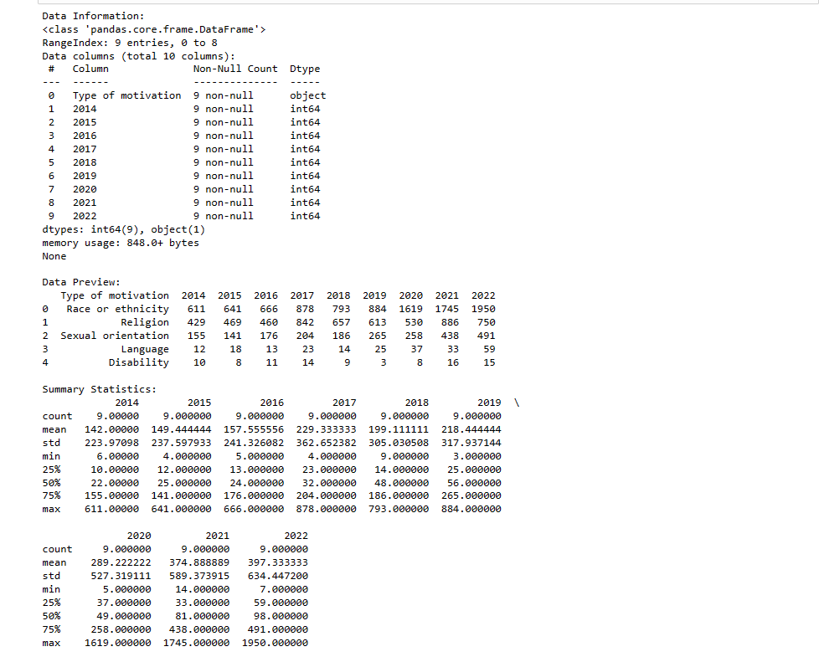
Exploratory Data Analysis (EDA) using Python
Python Code
Row Data
Cleaned Data

Slide 17
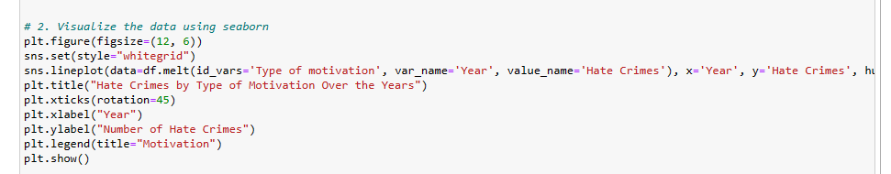
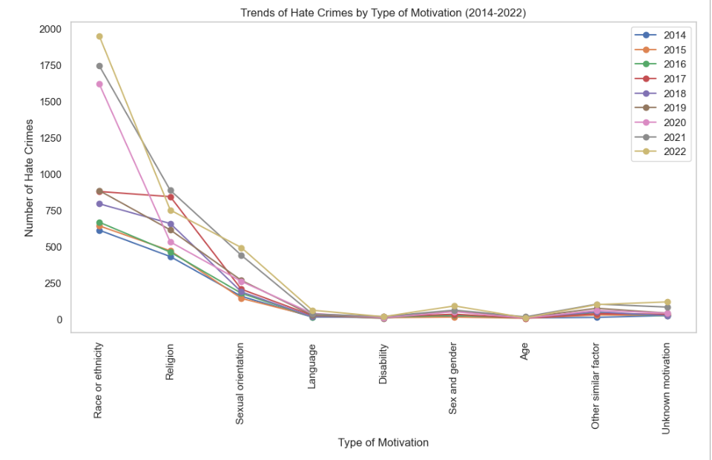
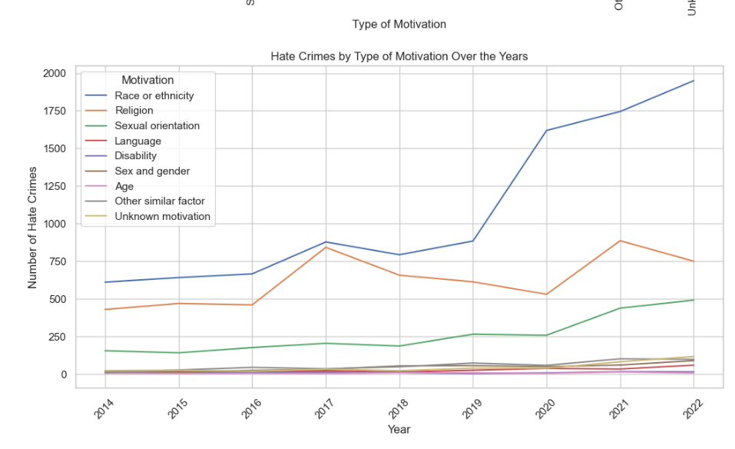
Using LinePlots
Exploratory Data Analysis (EDA) using Python

Slide 18
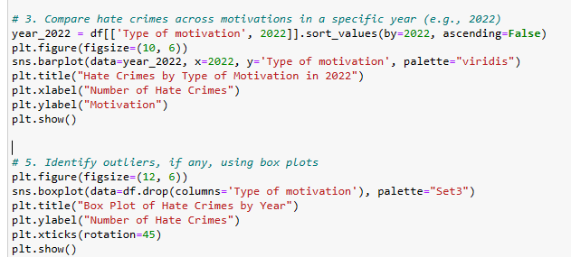
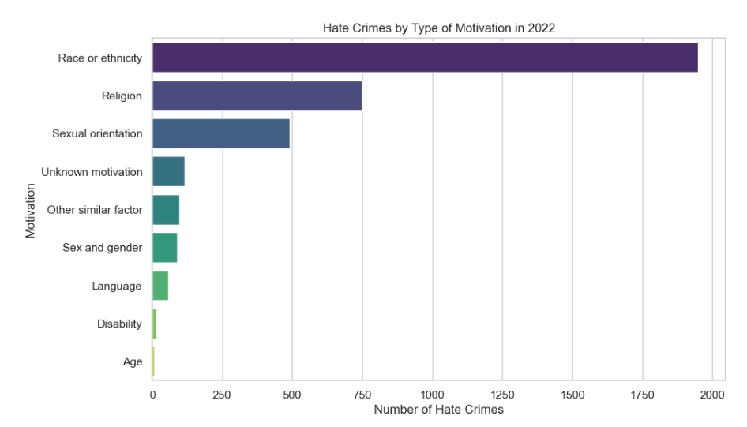
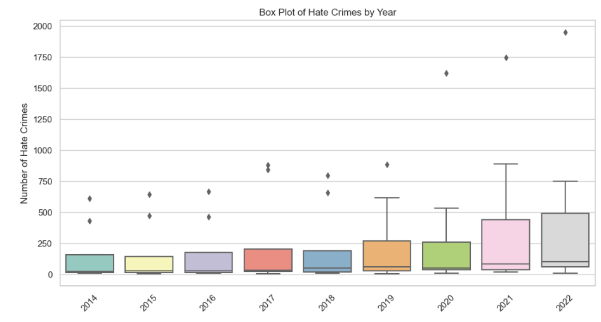
Using Bar Plot and Box Plot
Exploratory Data Analysis (EDA) using Python
Python Code
Row Data
Cleaned Data

Slide 19
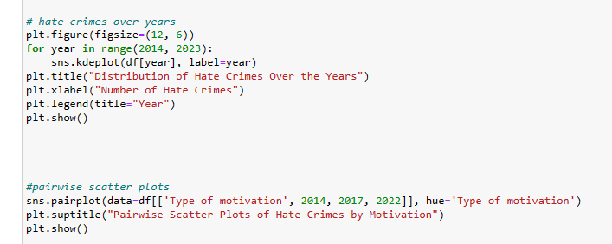
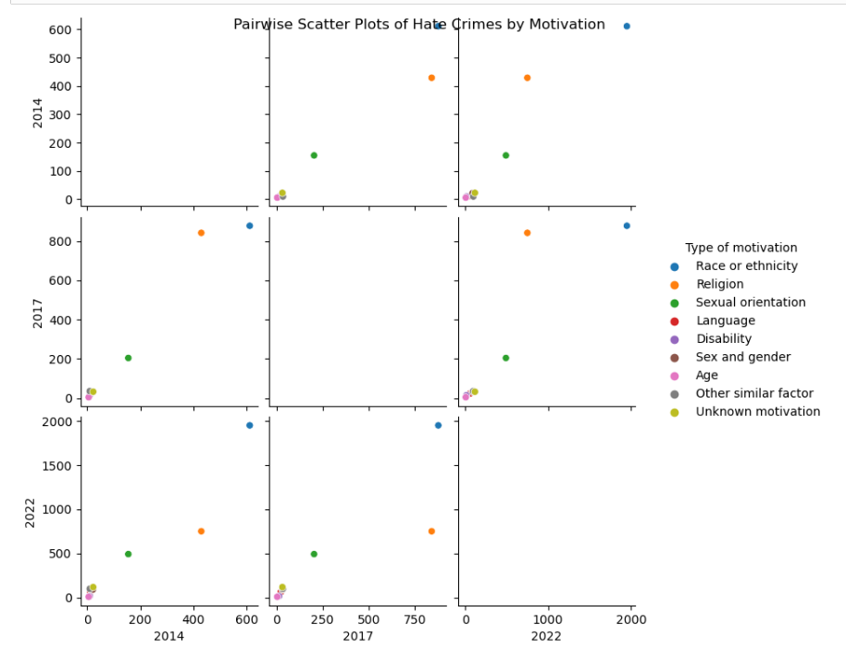
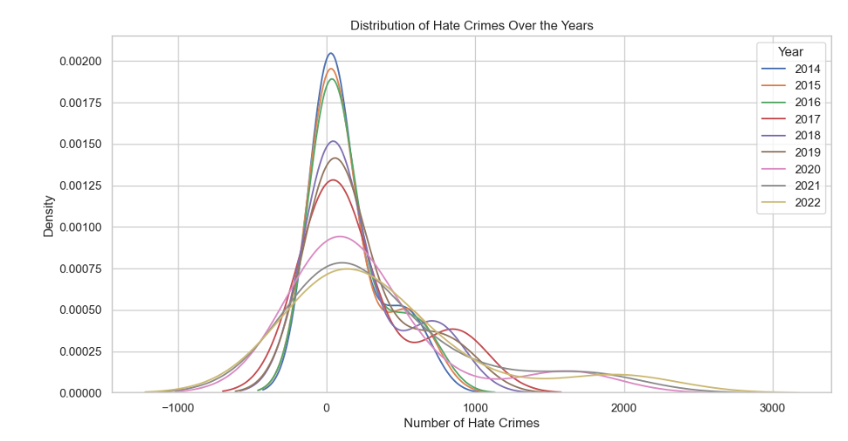
Scattered Plot
Exploratory Data Analysis (EDA) using Python
Python Code
Row Data
Cleaned Data

Slide 20

03
Development

Slide 21
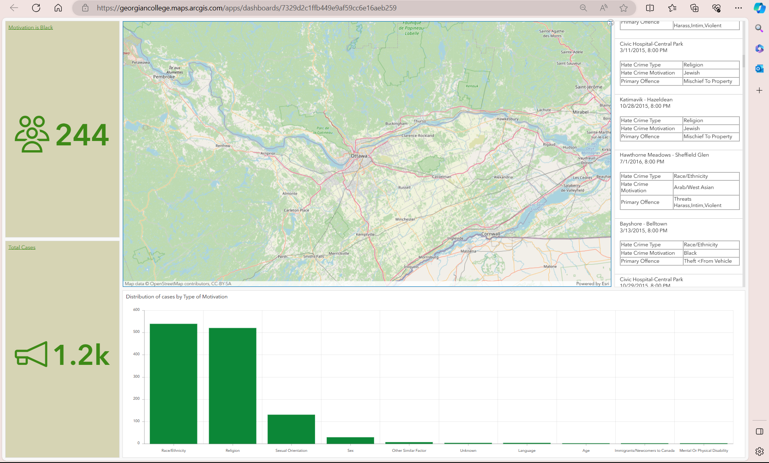
Data Visualization
PowerBI DASHBOARD
Ottawa Hate Crimes Dashboard (arcgis.com)

Slide 22
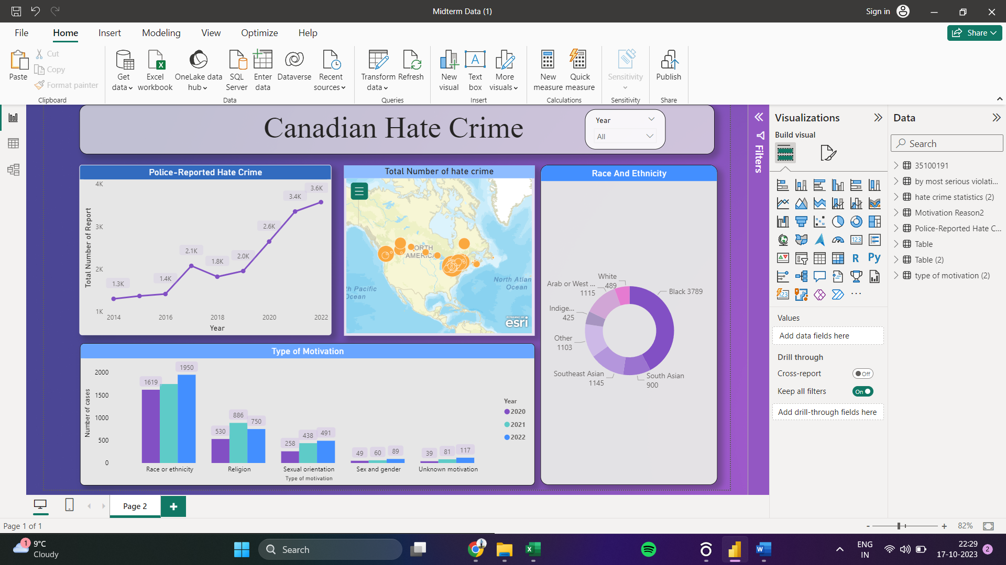
Data Visualization
PowerBI DASHBOARD

Slide 23
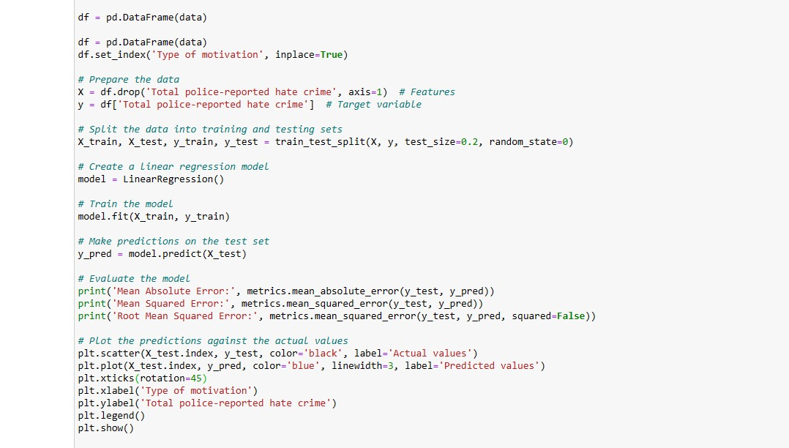
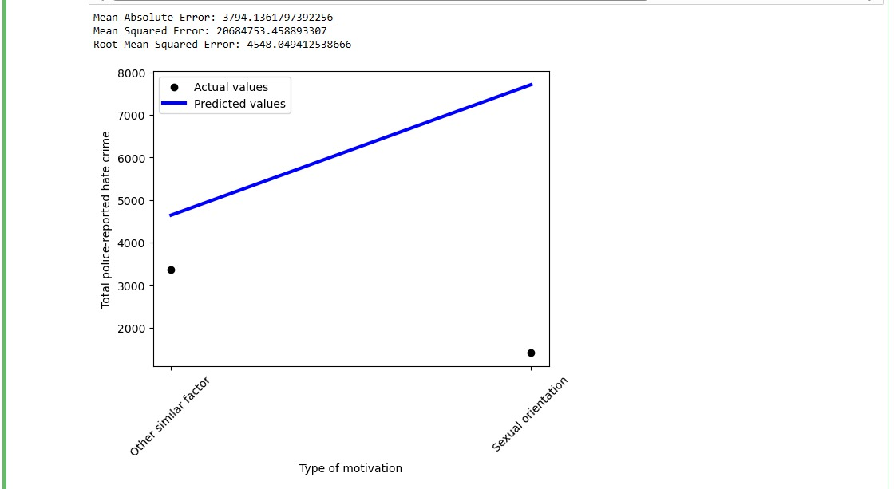
Predictive Analysis
Exploratory Data Analysis (EDA) using Python

Slide 24
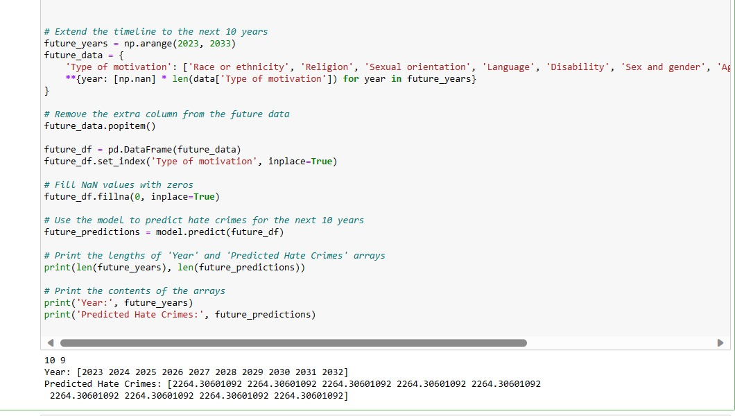
Predictive Analysis
Exploratory Data Analysis (EDA) using Python

Slide 25
Predictive Analysis
The projection of hate crimes escalating over the coming decade raises significant concerns about societal trends and the safety of marginalized communities. This worrisome anticipation suggests a potential surge in discriminatory incidents, posing challenges for law enforcement, advocacy groups, and policymakers. Understanding the underlying factors contributing to this predicted rise becomes imperative, emphasizing the urgency for proactive measures. Addressing root causes through education, community engagement, and policy reforms could serve as crucial strategies to counteract this disconcerting trajectory. Efforts toward fostering inclusivity, tolerance, and fostering empathy within communities are essential to mitigate the potential surge and create a more harmonious and equitable society for all.

Slide 26
COMMUNCATION AND TEAM MEETINGS
S.No | Date | Attendees | Medium | Agenda | Result
1 | 12-09-2023 | 1. Aravind Pradeep Kunnel 2. Omar Mukhtar 3. Namood-e-Sehar 4. Annee Amitkumar Mahida | Online(MS Teams) | Finalising the dataset and further process | Understood how to start with the datasets and what to do for the next week
2 | 13-09-2023 | 1. Namood-e-Sehar 2. Omar Mukhtar 3. Richard Lambroff 4. Annee Amitkumar Mahida 5. Aravind Pradeep Kunnel | Online(MS Teams) | Getting information on the datasets and regarding the weekly report | Succeeded in cleaning one dataset but still need more datasets.
3 | 18-09-2023 | 1. Namood-E-Sehar 2. Omar Mukhtar | Online (MS Teams) | Discussing upon finding the datasets and planned to work on cleaning dataset. | Discussion on searching different datasets and tasks assigned for each team members
4 | 19-09-2023 | 1. Namood-e-Sehar 2. Omar Mukhtar 3. Annee Amitkumar Mahida 4. Aravind Pradeep Kunnel | Online (MS Teams) | Discussing upon finding the datasets and assigning tasks for team members | Found out dataset and cleansed the dataset.
5 | 20-09-2023 | 1. Namood-e-Sehar 2. Omar Mukhtar 3. Richard Lambroff 4. Annee Amitkumar Mahida 5. Aravind Pradeep Kunnel

Slide 27
COMMUNCATION AND TEAM MEETINGS
S.No | Date | Attendees | Medium | Agenda | Result
6 | 21-09-2023 | 1.Namood-e-sehar 2.Omar Mukhtar 3. Anne Amitkumar Mahida 4 Aravind Pradeep Kunnel | Online (WhatsApp) | Discussing on what are the proposed tasks for coming week , especially authentic dataset | We try to do our work more efficiently and try our best to find some more relevant datasets
7 | 26-09-2023 | 1.Namood-e-sehar 2.Omar Mukhtar 3. Anne Amitkumar Mahida 4 Aravind Pradeep Kunnel | Online (WhatsApp) | Discussing what we have done about aur assigned tasks | Successful in finding one more dataset
8 | 27-09-2023 | 1.Namood-e-sehar 2.Omar Mukhtar 3. Anne Amitkumar Mahida 4 Aravind Pradeep Kunnel 5. Richard Lambrof | Teams | Discussing on what are the proposed tasks for the coming week , especially the authentic dataset and news search | Successful in finding relevant authentic datasets and news articles that can help us in making out decisions
9 | 29-09-2023 | 1.Namood-e-sehar 2.Omar Mukhtar 3. Anne Amitkumar Mahida 4 Aravind Pradeep Kunnel | Teams | Need for the new dataset. Got review for the weekly progress. | Successful in finding new datasets

Slide 28
COMMUNCATION AND TEAM MEETINGS
S.No | Date | Attendees | Medium | Agenda | Result
10 | 02-10-2023 | 1.Namood-e-sehar 2.Omar Mukhtar 3. Anne Amitkumar Mahida 4 Aravind Pradeep Kunnel | Teams | New dataset cleaned and some visualizations have been prepared. Comparisons have been made and some understanding of the topic and relevance of the topic was subjected to discussion. Several insights has been obtained. | Successful in making out figure
11 | 04-10-2023 | 1.Namood-e-sehar 2.Omar Mukhtar 3. Anne Amitkumar Mahida 4 Aravind Pradeep Kunnel 5. Richard Lamboff
12 | 10-10-2023 | 1.Namood-e-sehar 2.Omar Mukhtar 3. Anne Amitkumar Mahida 4 Aravind Pradeep Kunnel | Teams | Weekly meeting with the team members on making additional visualization and assuring that all the important causes of hatecrimes are discussed. | Better understanding on the statistics of hate crime
13 | 11-10-2023 | 1.Namood-e-sehar 2.Omar Mukhtar 3. Anne Amitkumar Mahida 4 Aravind Pradeep Kunnel 5.Richard Lambroff | Teams | Weekly meeting with the team members on making additional visualization and assuring that all the important causes of hatecrimes are discussed. | Better understanding on the statistics of hate crime
14 | 13-10-2023 | 1.Namood-e-sehar 2.Omar Mukhtar 3. Anne Amitkumar Mahida 4 Aravind Pradeep Kunnel | Teams | Discussion on finalizing the datasets, cleaning it and extracting data for making visuals. | Discussion on making new PowerBI dashboard and weekly updates
15 | 16-10-2023 | 1.Namood-e-sehar 2.Omar Mukhtar 3. Anne Amitkumar Mahida 4 Aravind Pradeep Kunnel | Teams | PowerBI Dashboard is created with all the main visualizations in it. Weekly status and MRP SharePoint is also updated. | PowerBI Dashboard is created and SharePoint updated

Slide 29
COMMUNCATION AND TEAM MEETINGS
S.No | Date | Attendees | Medium | Agenda | Result
16 | 18-10-2023 | 1.Namood-e-sehar 2.Omar Mukhtar 3. Anne Amitkumar Mahida 4 Aravind Pradeep Kunnel 5. Richard Lambroff | Teams | Weekly status report 6 | Better understanding on the statistics of hate crime
17 | 30-10-2023 | 1.Namood-e-sehar 2.Omar Mukhtar 3. Anne Amitkumar Mahida 4 Aravind Pradeep Kunnel | Teams | Discussion on finalizing the datasets, cleaning it and extracting data for making visuals. | Discussion on making new PowerBI dashboard and weekly updates
18 | 01-11-2023 | 1.Namood-e-sehar 2.Omar Mukhtar 3. Anne Amitkumar Mahida 4 Aravind Pradeep Kunnel 5.Richard Lambroff | Teams | Weekly status report 7 | We need more visualizations in order to give our perspective.
19 | 07-11-2023 | 1.Namood-e-sehar 2.Omar Mukhtar 3. Anne Amitkumar Mahida 4 Aravind Pradeep Kunnel | Teams | Discussing how to dive deep into required visualization | Successful in creating visualizations
20 | 08-11-2023 | 1.Namood-e-sehar 2.Omar Mukhtar 3. Anne Amitkumar Mahida 4 Aravind Pradeep Kunnel 5.Richard Lambroff | Teams | Advice us on to do prediction modeling | Satisfied with our work

Slide 30
COMMUNCATION AND TEAM MEETINGS
S.No | Date | Attendees | Medium | Agenda | Result
21 | 14-11-2023 | 1.Namood-e-sehar 2.Omar Mukhtar 3. Anne Amitkumar Mahida 4 Aravind Pradeep Kunnel | WhatsApp | Discuss how to do Prediction analysis | Starts working on it
22 | 21-11-2023 | 1.Namood-e-sehar 2.Omar Mukhtar 3. Anne Amitkumar Mahida 4 Aravind Pradeep Kunnel | WhatsApp | Working on Prediction analysis and presentation for weekly development report. | We are successful in producing some prediction analysis and presentation
23 | 2-12-2-23 | 1.Namood-e-sehar 2.Omar Mukhtar | WhatsApp | Discussing prediction modeling | We finalize some pf predictions
24 | 3-12-2023 | 1.Namood-e-sehar 2.Omar Mukhtar 3. Anne Amitkumar Mahida 4 Aravind Pradeep Kunnel | WhatsApp | Presentation stuff and need to update SharePoint | We start working on presentation and SharePoint thingy

Slide 31

Model Interpretability:
Complex predictive models might lack interpretability, making it challenging to explain why certain predictions are made. Ensuring transparency in the model's decision-making process is crucial.
Feature Selection and Engineering:
Selecting the right features (variables) and engineering them effectively to represent the complexities of hate crimes is a critical aspect. Determining which factors to include or exclude can impact the model's performance.
ISSUES AND CHALLENGES

Slide 32
Implement Actionable Strategies:
ACTIVITIES TO BE COMPLETED BEFORE NEXT REPORT
Develop actionable strategies based on the predictive analysis results
Documentation and Archiving
Document all steps, methodologies, and findings thoroughly. Create an archive for your analysis, ensuring that it's well-documented and accessible for future reference or updates.

Slide 33

Thank You

